Slide 1
SimSDF: Physically-Based Simulation with Signed Distance Fields
Zichen Wang, Xilai Dai, Barry Lyu

Slide 2
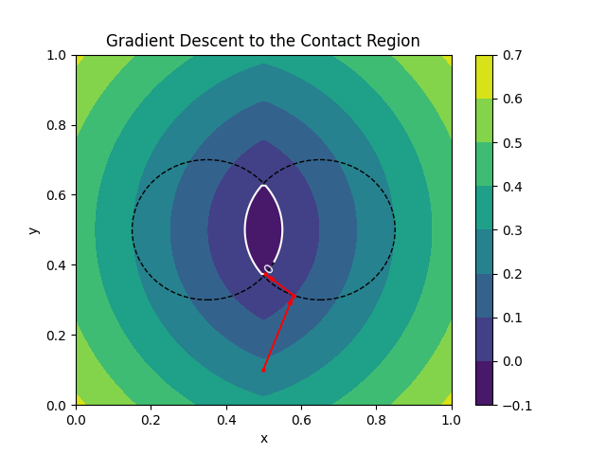
SDF Collision Detection
Take max SDF between the SDFs
to two spheres
Gradient Descent to the colliding
point

Slide 3
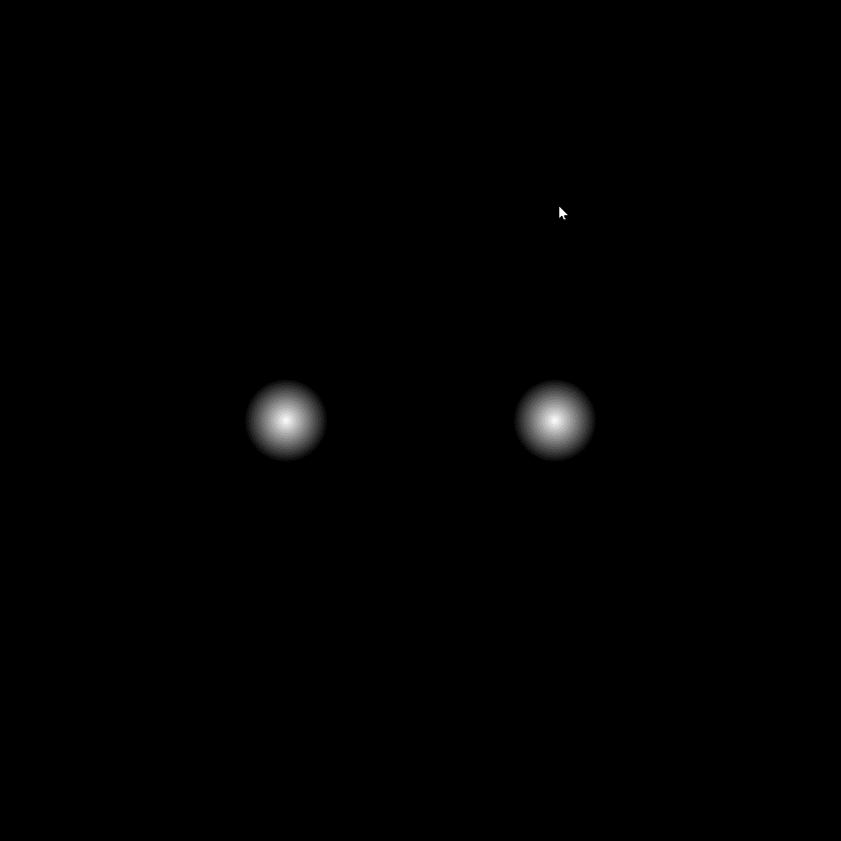
SDF Collision Detection (cont.)

Slide 4
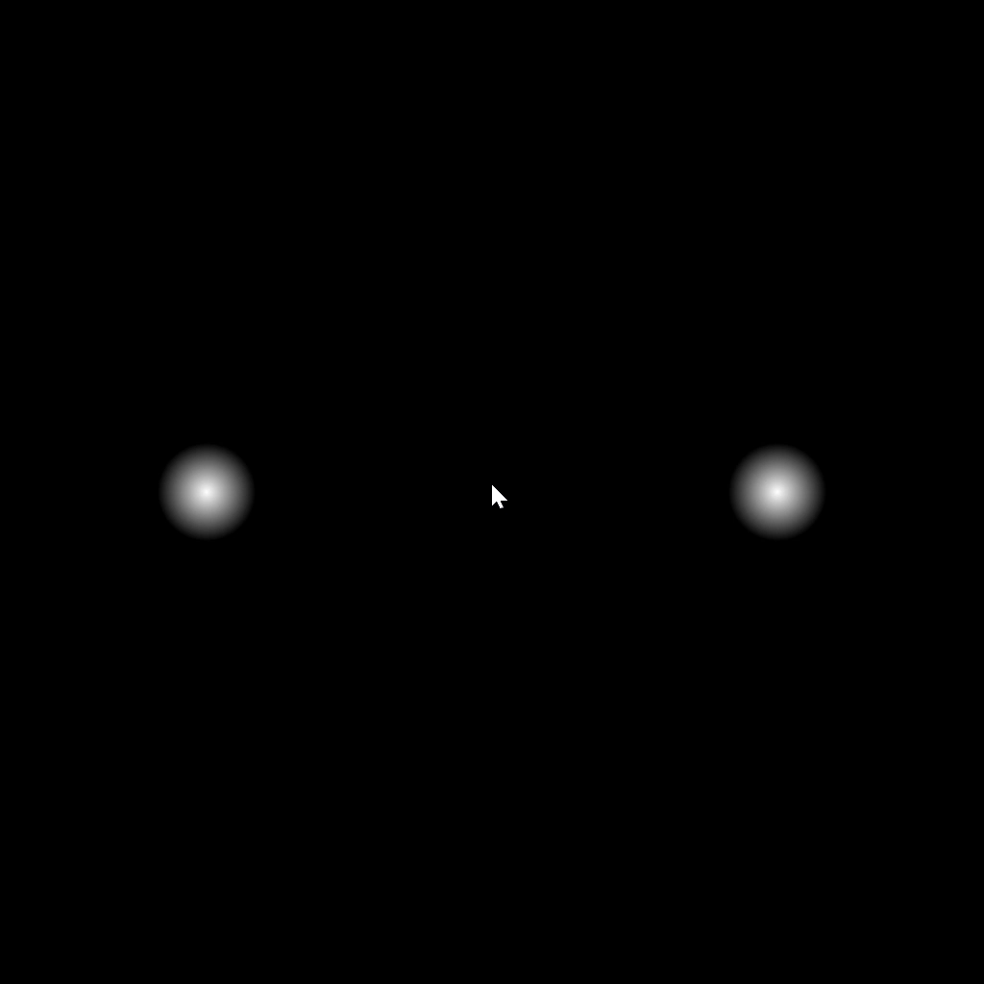
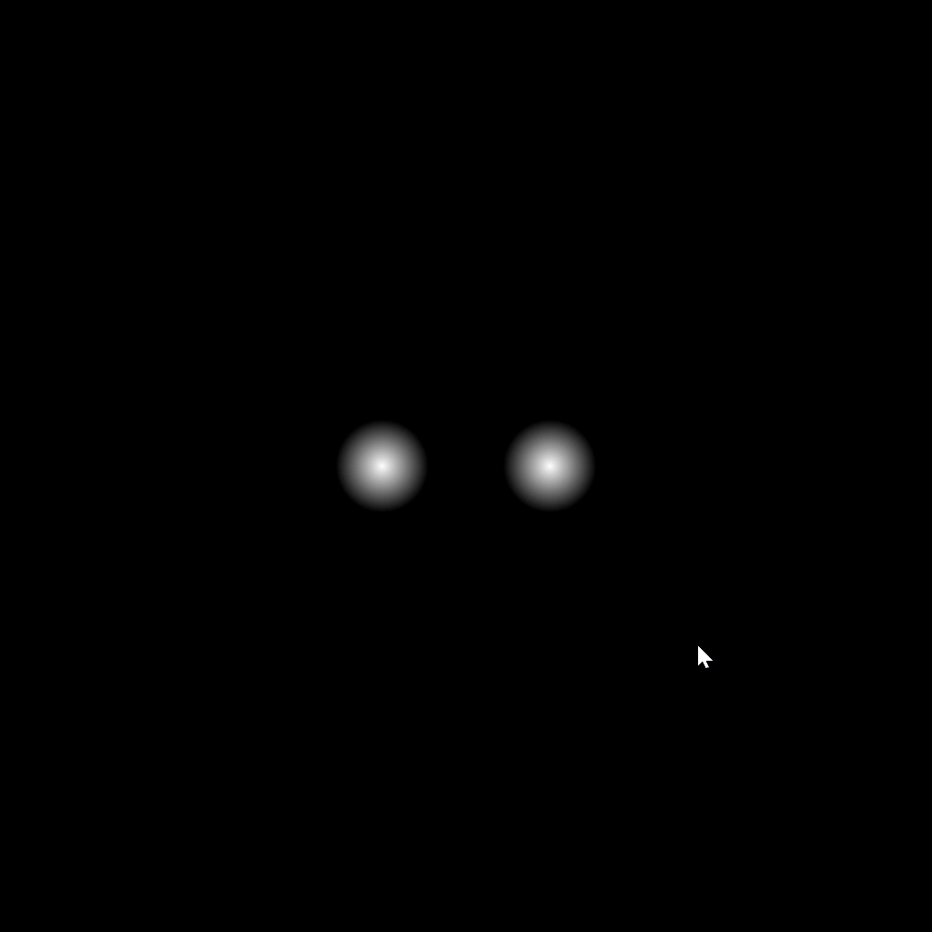
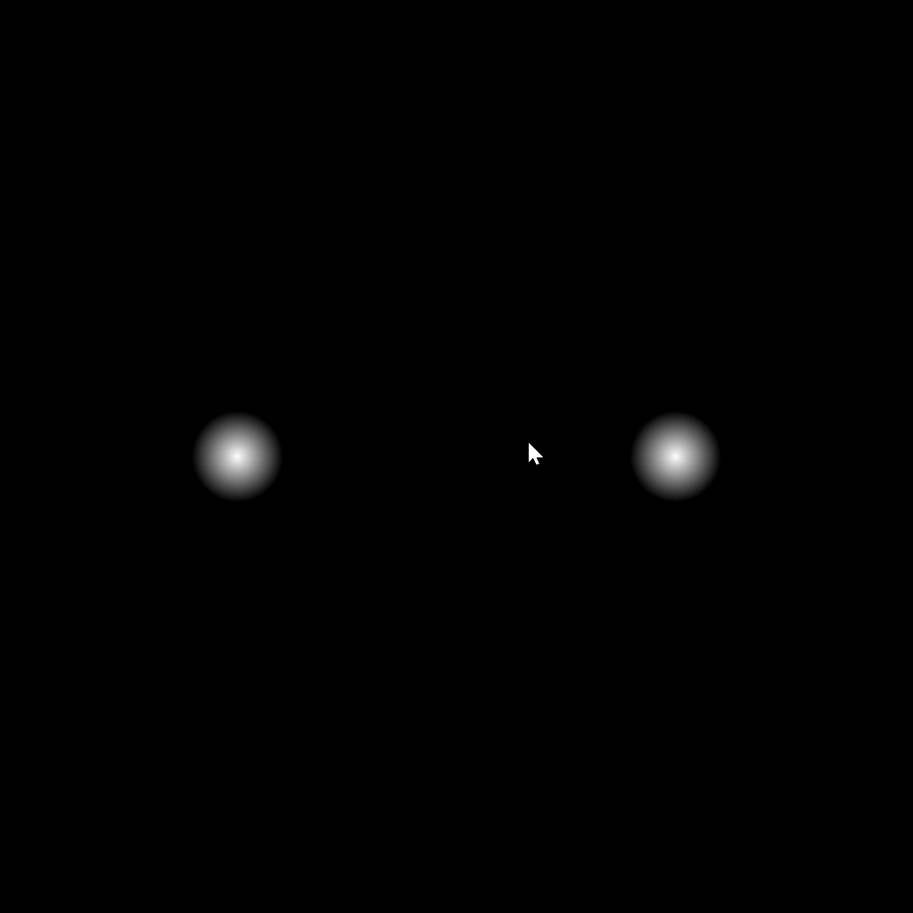

Experiments
Particle
20 FPS
n = (1, 0)
Mesh of 32 vertices
20 FPS
n = (0.995185, -0.098017)
Mesh of 256 vertices
1.6 FPS
n = (0.999925, 0.012288)
SDF (ours)
20 FPS
n = (1, 0)

Slide 5
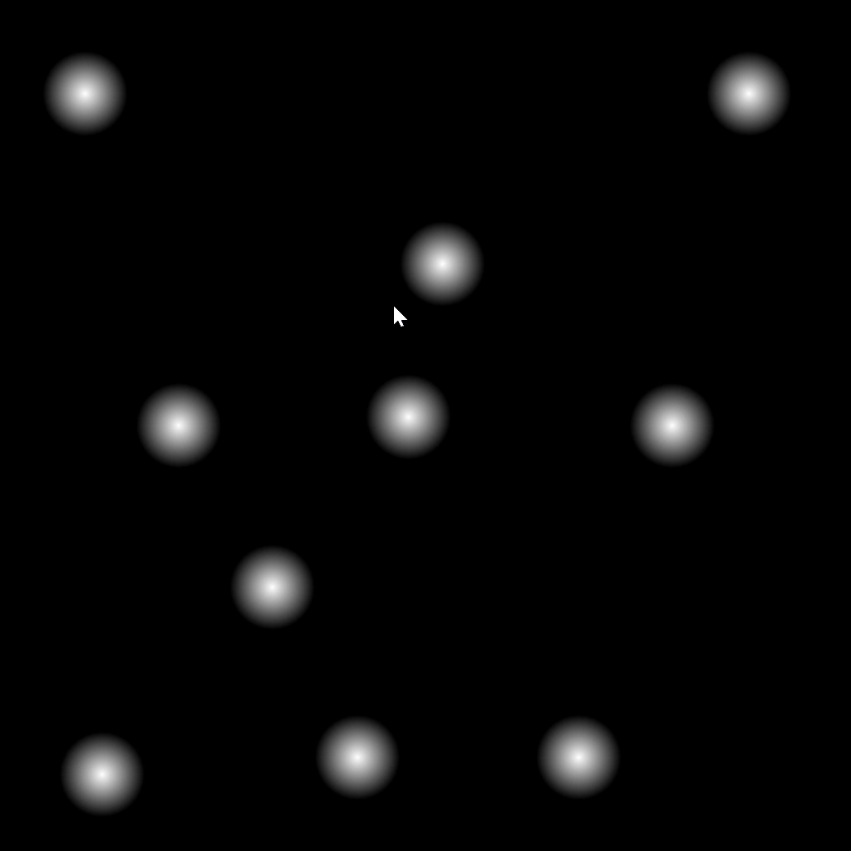
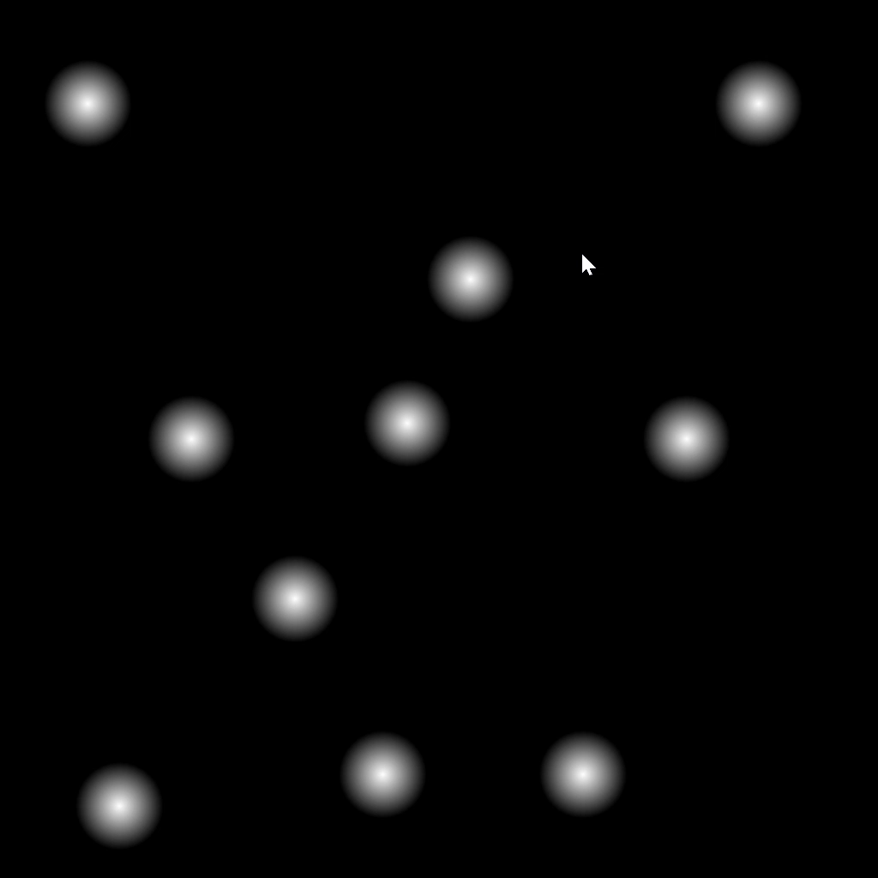

Experiments (cont.)
Particle
Mesh
SDF (ours)
* Colliding spheres seem to have gaps because of shading. Red dots denote colliding points that are not addressed timely.

Slide 6
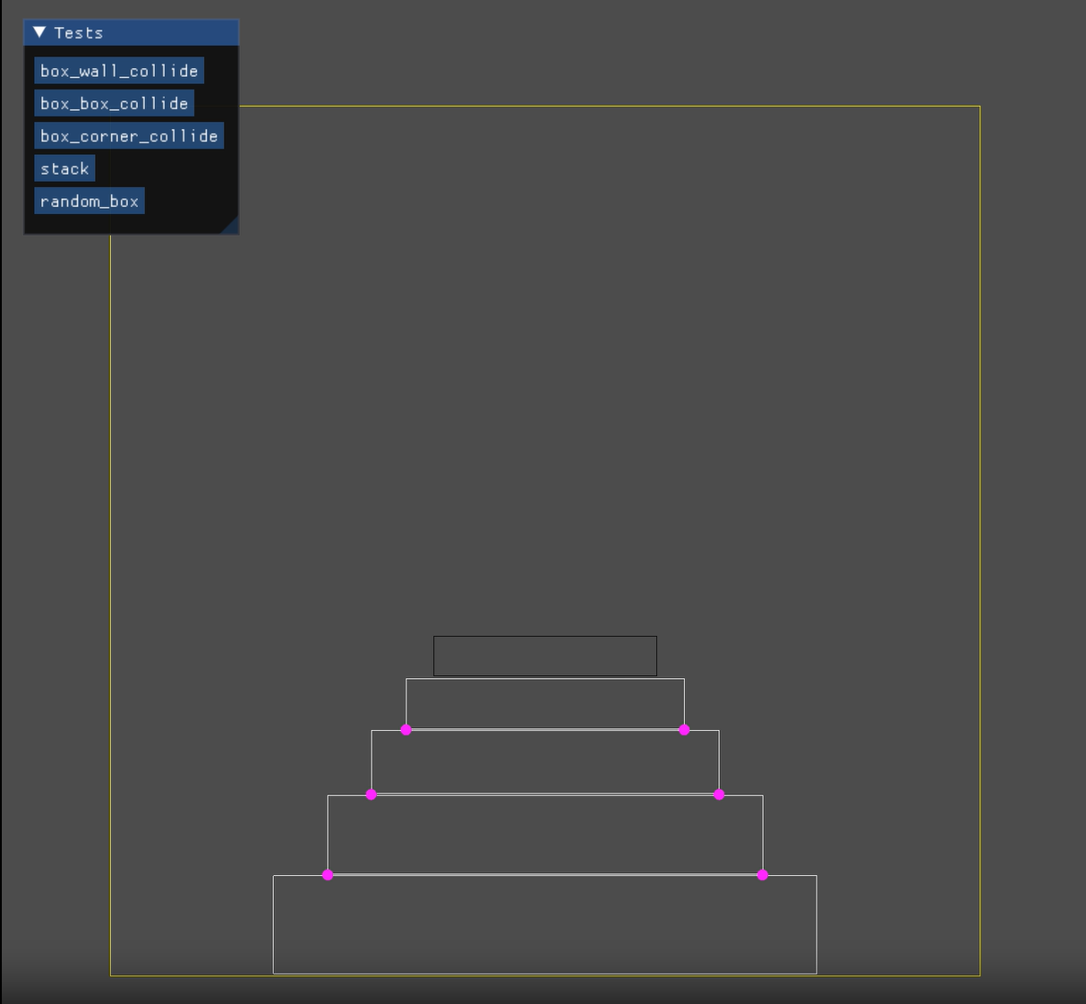
Discussions
Extend to general shapes
Handle simultaneous colliding points
Support sharp edges
Modify SDF to simulate soft bodies

Slide 7
Thank you!

